Slide 1
Chapter 3: The cellular basis of life
Cells were discovered in 1665 by Robert Hooke after the invention of the microscope
  He described the cells as tiny boxes or a honeycomb
  He thought that cells only existed in plants and fungi
In 1673, Anton van Leeuwenhoek: first observed living cells, and called them animalcules (little animals)
1838- German Botanist, Matthias Schleiden, reported that all plant parts are made of cells
1839- German physiologist, Theodor Schwann, stated that all animal tissues are composed of cells.

Slide 2
The cellular basis of life…..
1839- German doctor, Rudolf Virchow, stated All cells only arise from pre-existing cells
The Cell Theory
Based on the previous discovery, the cell theory was stated as
All organisms are composed of cells
Cells are the smallest living things
Cells arise only from pre-existing cells

Slide 3
Size and Shape of cells
Cell size
Most cells are relatively small
Cells size ranges from less than 1 micrometre - 200 micrometres.
Why cell size is limited? What is the advantage of being small?
The size of a cell is directly related to its level of activity and the rate that molecules move across its membranes
Rate of diffusion of materials into and out of the cell is affected by surface area available
Smaller cells have higher surface area to volume ratio so things can be moved in and out efficiently

Slide 4
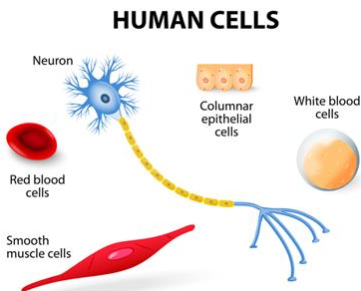
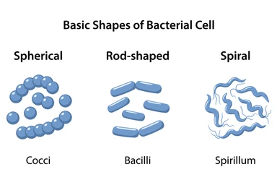
Cell shape
Cells also show great variation in their shape.
In human beings for example, there are about 200 types of cells that vary greatly in shape

Slide 5
Methods to study cells
Many cells are not visible to the naked eye
  Most cells are < 50 μm in diameter
  the study of cells thus depended heavily on the use of microscopes
Microscopes
are optical instruments that can magnify and resolve the image of an object
Magnification: the process of enlarging the apparent size (Image) of an object.
Microscopes are capable of magnifying image objects up to about thousands to millions of times

Slide 6
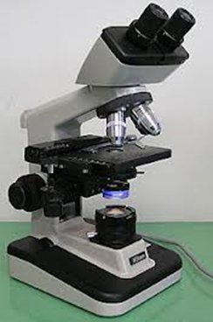
Resolution – the ability of a microscope to distinguish objects separated by small distances—is even more important than magnification. Human eye resolution = 100 μm
Types of Microscopes
Light microscopes
Use glass lenses to magnify the image of an object up to 1500X
Use visible light to illuminate an object
Resolve structures that are 200 nm apart
Most subcellular structures, including organelles (membrane-enclosed compartments), are too small to be resolved by an LM

Slide 7
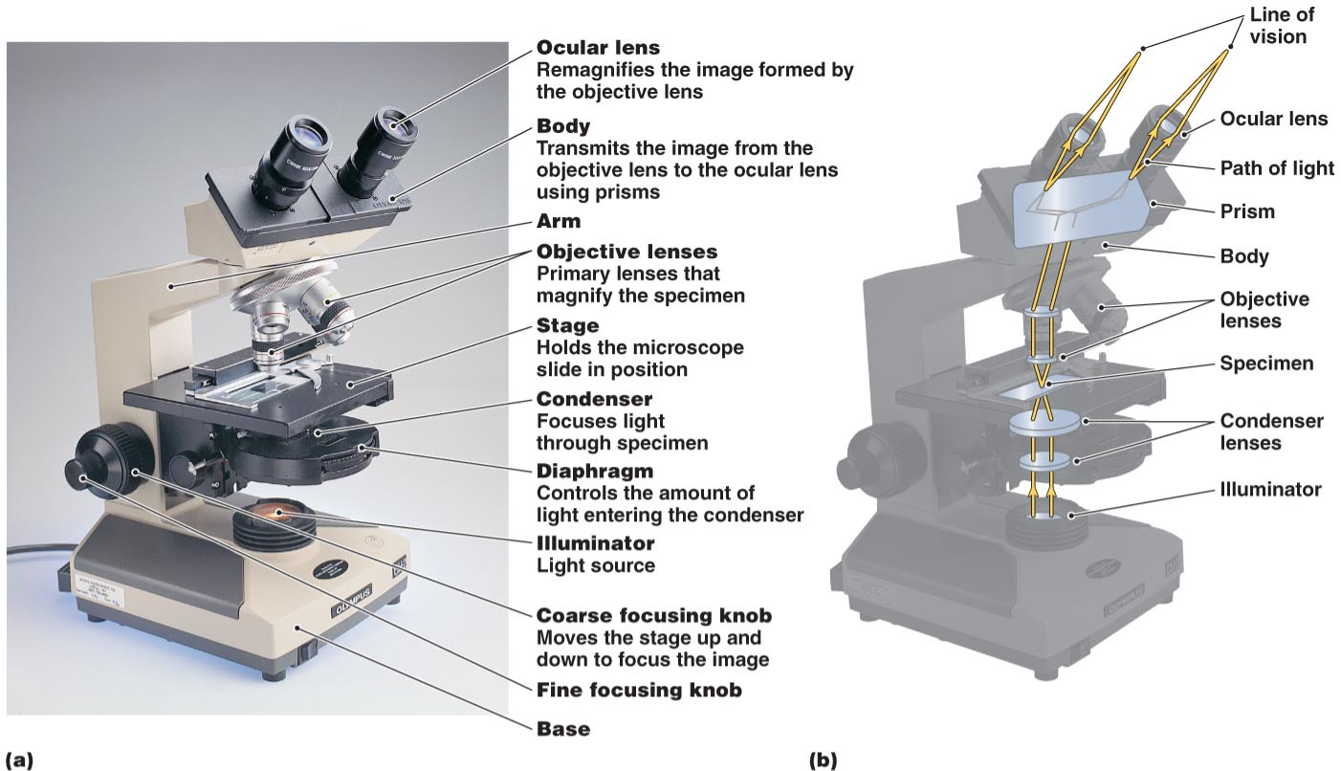
Parts and functions of compound light microscope

Slide 8
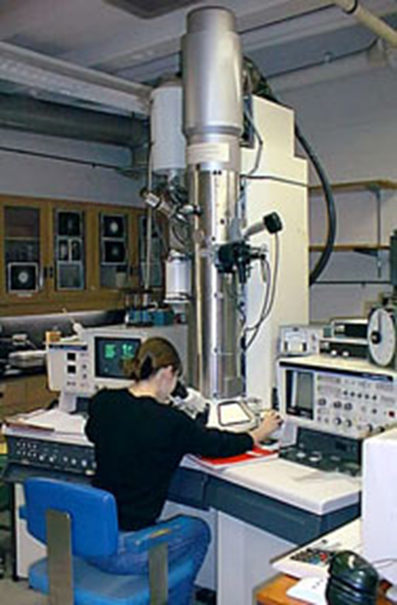
Electron microscopes
have greater resolving power and magnification than light microscopes
Use electromagnetic lense to magnify 10,000X to 500,000X
use a beam of electrons to illuminate an object
Resolve structures that are 0.2 nm apart
Used for detailed views of bacteria, viruses, internal cellular structures(organelles), molecules, and large atoms
Two types: Transmission and Scanning electron microscopes

Slide 9
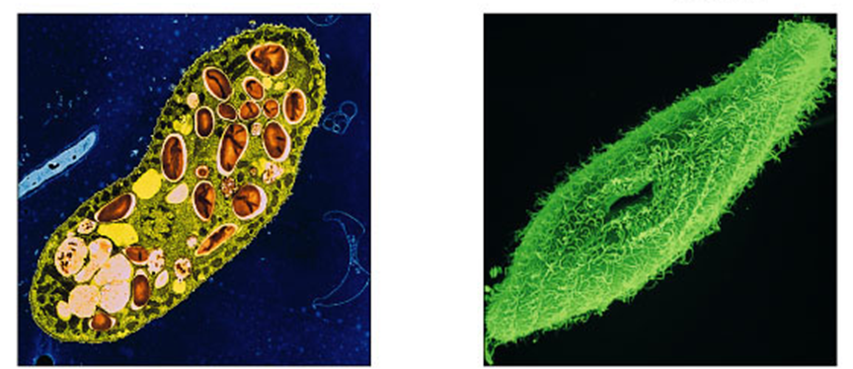
Electron microscopes:
Transmission electron microscopes (TEM)
transmit electrons through the material
used to study internal cellular ultrastructure.
Scanning electron microscopes (SEM)
beam electrons onto the specimen surface
used to provide a three-dimensional image of cells.
TEM
SEM

Slide 10
Levels of cellular organization
Unicellular organisms: organisms with only one cell (e.g., Bacteria, Archea, Some algae, Protozoa, etc.).
Multicellular organisms: organisms having many cells in their body. (e.g., most plants, animals and fungi).
Any cellular organism may contain either prokaryotic or eukaryotic cell types
Only organisms of the domains Bacteria and Archaea consist of prokaryotic cells
Protists, fungi, animals, and plants all consist of eukaryotic cells

Slide 11
Basic features of all cells
  All cells (prokaryotic and eukaryotic) possess
  Plasma membrane (Cell membrane)
  Semifluid substance called cytosol (cytoplasm)
  Chromosomes (carry genes)
  Ribosomes (synthesize proteins)

Slide 12
Prokaryotic Cells
The prokaryotic (Gr., pro = primitive or before; karyon = nucleus) are small, simple and most primitive.
Lack a membrane-bound nucleus
  DNA in the nucleoid
Lacks internal membrane structures
Contain Cell wall outside of plasma membrane
Possess ribosomes: machinery for protein synthesis
Constitute two Domains : Archaea and Bacteria

Slide 13
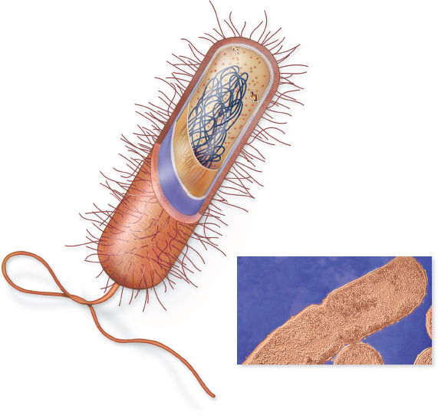
Example of Bacterial cell structure
Pilus
Cytoplasm
Ribosomes
Nucleoid (DNA)
Plasma membrane
Cell wall
Capsule
Pili
Flagellum
0.3 µm
© Phototake

Slide 14
Prokaryotic Cells
Bacterial Cell Walls:
Most bacterial cells possess a strong cell wall
  composed of peptidoglycan
Functions include…
  Protection
  Maintains cell shape
  Prevents excessive H₂O uptake
Archaea lack peptidoglycan
Capsule: gelatinous covering external to the cell wall (not always present)

Slide 15
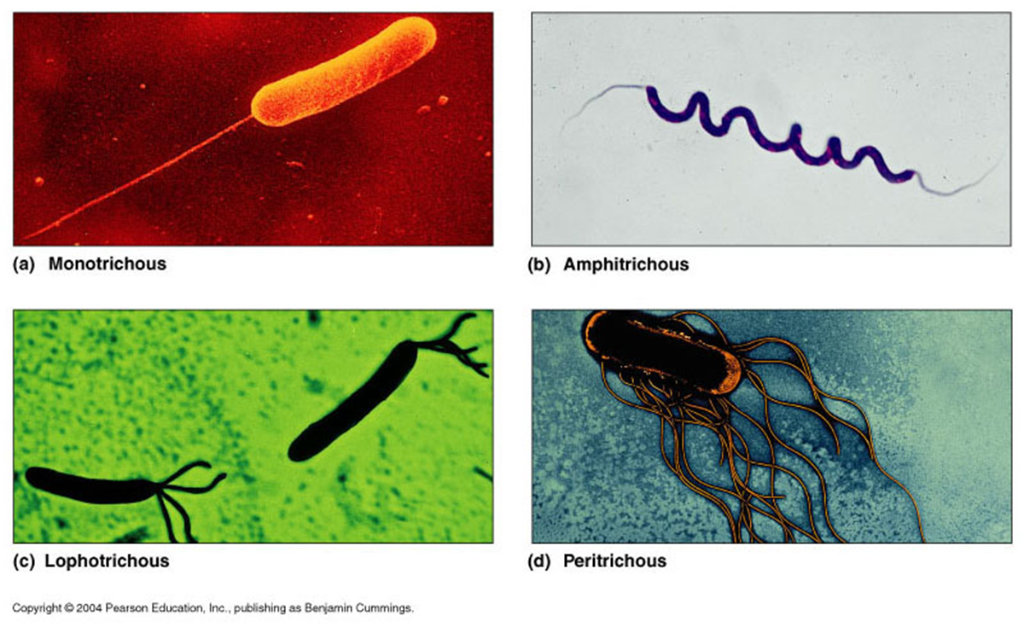
Prokaryotic Cells
Flagella:
Present in some prokaryotic cells
  May be one or more or none
Used for locomotion

Slide 16
Eukaryotic Cells
The eukaryotic cells (Gr., eu=true, karyon=nucleus). Possess a membrane-bound nucleus
More complex than prokaryotic cells
Show cytoplasmic compartmentalization (subdivided into functionally distinct, membrane-bound compartments called organelles)
organelles within cells are specialized for one or more functions
Also possess a cytoskeleton for
  support
  maintain cell structure

Slide 17
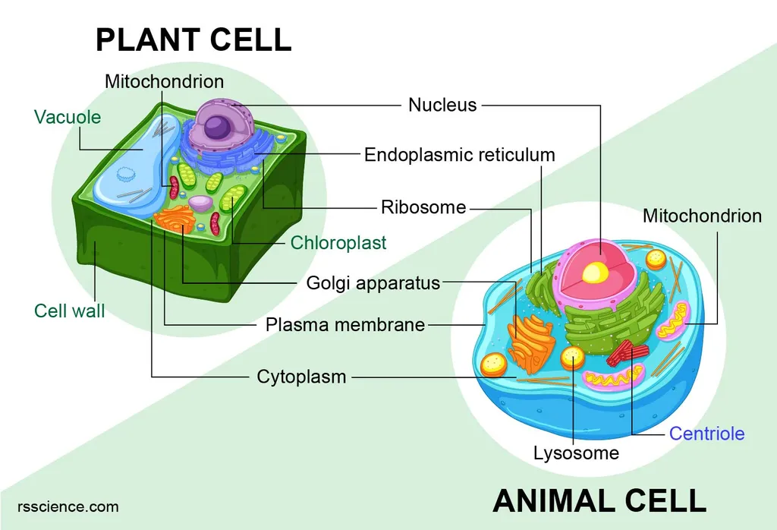

Slide 18
Organelles
Nucleus
Storage of cell’s genetic information (DNA)
is the largest organelle surrounded by two Nuclear envelopes
  Possess Nuclear pores – control transport in and out
Contain Nucleolus (one, two or four per nucleus)– a region where ribosomal RNA (rRNA) synthesis takes place
The space between the nuclear envelope and the nucleolus is filled by nucleoplasm
cells contain a single nucleus but the number of the nucleus may vary from cell to cell.

Slide 19
Ribosomes
non membrane bounded cytoplasmic organelle found in all Organisms
Cell’s protein synthesis machinery
Composed of: Ribosomal RNA (rRNA) and protein complex
function either free in the cytosol or bound to endoplasmic reticulum.
two types of ribosomes have been recognized
  70s in prokaryotes
  80s in eukaryotes

Slide 20
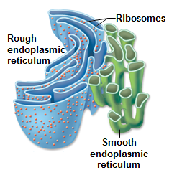
Endoplasmic Reticulum
Endoplasmic reticulum (ER) = (Endoplasmic = within the cytoplasm; reticulum =network); extensive membranous network of membranes in the cell
Two types
1. Rough endoplasmic reticulum (RER)
  Attachment of ribosomes to the membrane gives a rough appearance
  Involved in the Synthesis of proteins and membranes

Slide 21
Endoplasmic Reticulum
2. Smooth endoplasmic reticulum (SER)
  Appears smooth in the electron microscope because its cytoplasmic surface lacks ribosomes.
  Have a variety of functions:
  synthesize lipids,
  Metabolizes carbohydrates
  store Ca²⁺,
  detoxify drugs and poisons

Slide 22
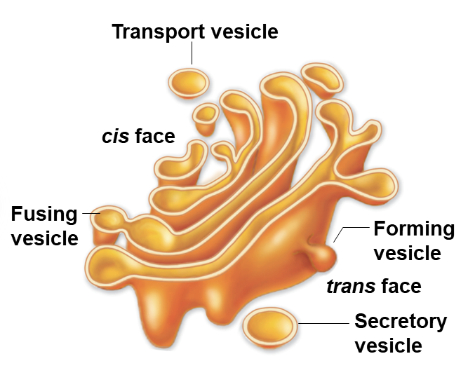
Golgi Apparatus (Golgi bodies)
Flattened stacks of interconnected membranes
Functions in packaging and distribution of molecules
Vesicles transport molecules to the destination

Slide 23
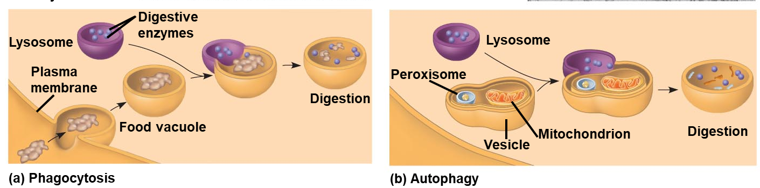
Lysosomes (Digestive Compartments)
Membrane-bounded digestive vesicles
Arise from Golgi apparatus
Store Enzymes that hydrolyze proteins, fats, polysaccharides, and nucleic acids
destroy cells or foreign matter taken in by phagocytosis
recycle the cell’s own organelles and macromolecules, a process called autophagy

Slide 24
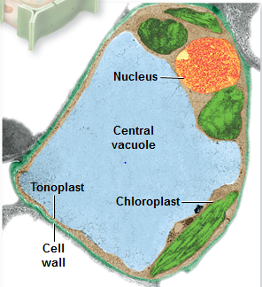
Vacuoles
Membrane-bounded structures in plants, fungi and protists
Various functions depending on the cell type
  Central vacuole: in plant cells hold organic compounds and water (maintain turgor pressure)
  Contractile vacuole: in some fungi and protists pump excess water out of cells
  Storage vacuoles

Slide 25
Mitochondria
Found in all types of eukaryotic cells
Used for cell respiration (ATP energy production = powerhouse of the cell)
Bound by 2 membranes
  Outer membrane and inner membrane separated by Intermembrane space
  The inner membrane has folds known as cristae (site for electron transport system)
  Space inside the inner membrane is Matrix (site for Kreb cycle)
Have their own DNA

Slide 26
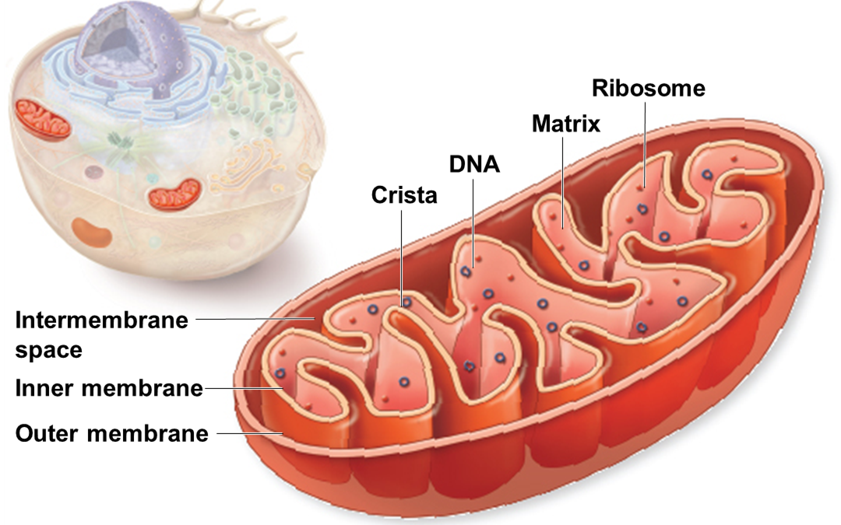

Slide 27
Chloroplasts
Organelles present in cells of plants and some other eukaryotes
Contain chlorophyll for photosynthesis
Surrounded by 2 membranes
membranous sacs within the inner membrane are called Thylakoids (contain chlorophyll and are the site light reaction):
  stacks of thylakoids are known as Grana
the fluid matrix inside chloroplast is called Stroma (site of dark reaction of CO2 fixation)
Have their own DNA

Slide 28
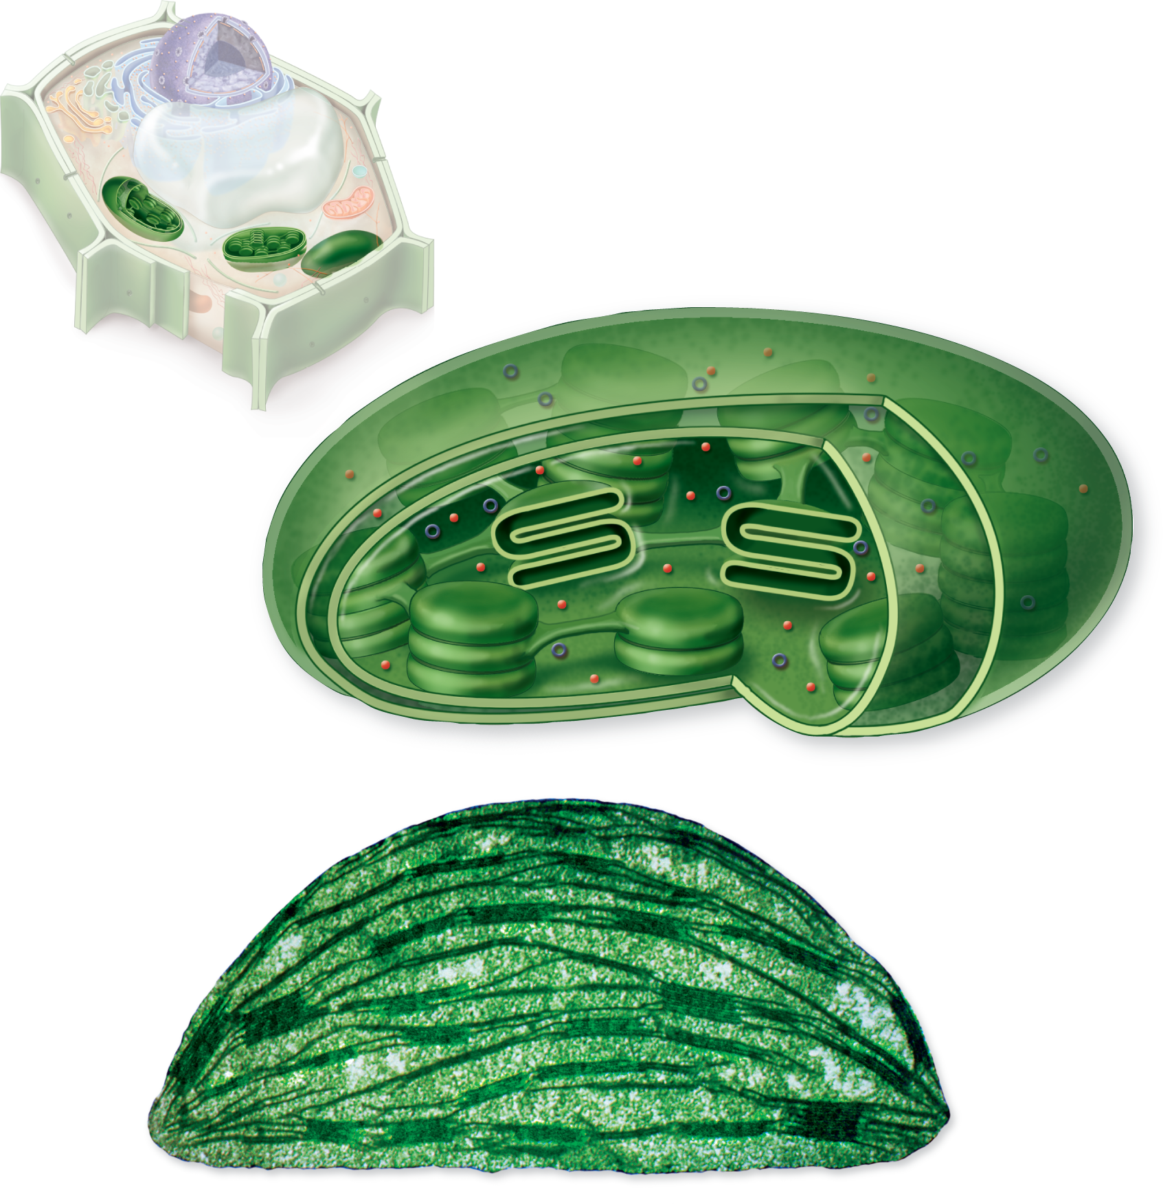
Ribosome
DNA
Thylakoid
membrane
Outer
membrane
Inner
membrane
Thylakoid disk
Granum
Stroma
Stroma
Granum
1.5 µm
(inset): © Dr. Jeremy Burgess/Photo Researchers, Inc.

Slide 29
Peroxisomes:
Peroxisomes are specialized metabolic compartments bounded by a single membrane
Peroxisomes produce hydrogen peroxide and convert it to water
Oxygen is used to break down different types of molecules

Slide 30
Endosymbiosis
The endosymbiotic theory is the idea that a long time ago, prokaryotic cells engulfed other prokaryotic cells by endocytosis. This resulted in the first eukaryotic cells.
Explains the evolution of eukaryotic cells from simple prokaryotic organisms.
Focuses mainly on the origins of chloroplasts and mitochondria

Slide 31
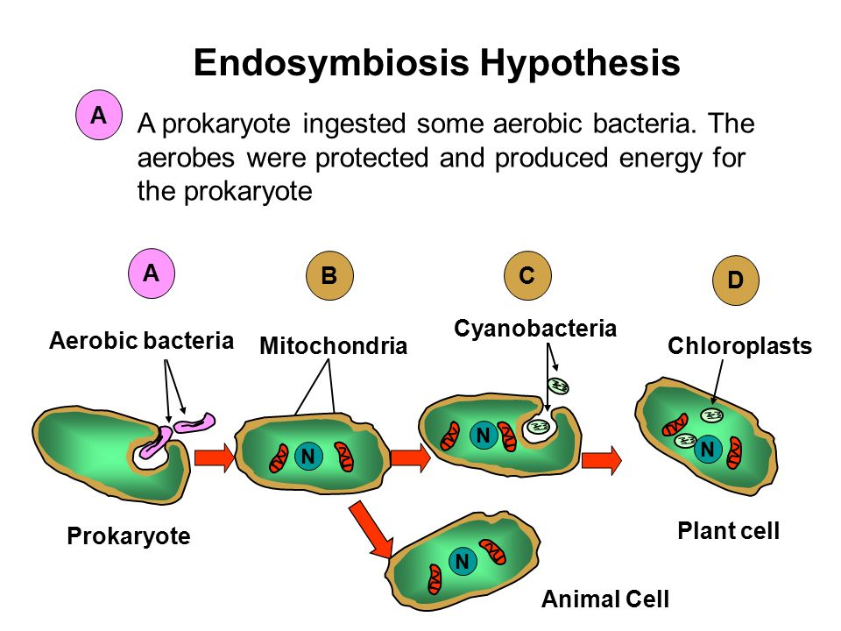

Slide 32
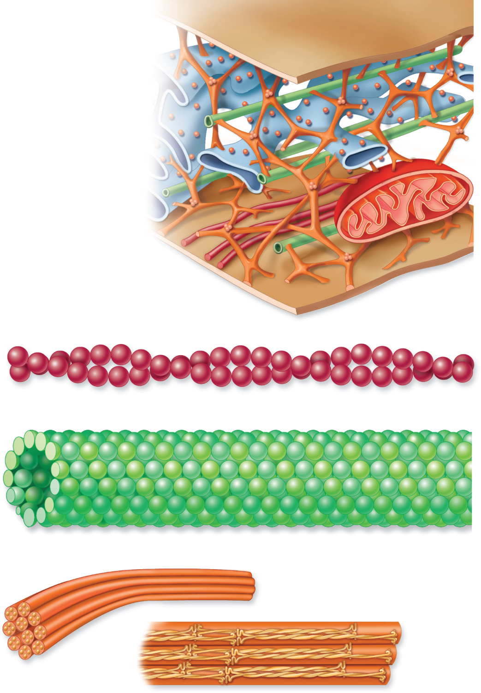
Cytoskeleton
Network of protein fibers found in all eukaryotic cells
  Supports the shape of the cell
  Keeps organelles in fixed locations
It is composed of three types of molecular structures:
  Microfilaments
  Microtubules
  Intermediate filaments
Microtubule
Intermediate filament
Actin filament
Cell membrane

Slide 33
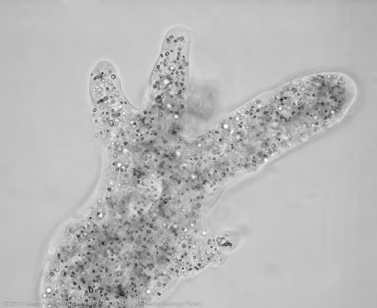
Cytoskeleton: 3 types of fibers
Microfilaments (actin filaments)
  Two protein chains loosely twined together
  Used for movements like contraction, crawling, “pinching”
Ameboid Movement
Microtubule
Intermediate filament
Actin filament
Cell membrane
a. Actin filaments

Slide 34
Microtubules
  Largest of the cytoskeletal elements
  Dimers of α- and β-tubulin subunits
  Functions
  Shaping the cell
  Guiding movement of organelles
  Separating chromosomes during cell division
Microtubule
Intermediate filament
Actin filament
Cell membrane
b. Microtubules

Slide 35
Intermediate filaments
  Between the size of actin filaments and microtubules
  Very stable – usually not broken down
  Example: Keratin
They support cell shape and fix organelles in place
Microtubule
Intermediate filament
Actin filament
Cell membrane
c. Intermediate filament

Slide 36
Centrosomes
Located near the nucleus
Is Microtubule-organizing center
  Can nucleate the assembly of microtubules
Animal cells and most protists have centrioles – pair of organelles
Organize microtubules for cell division
Plants and fungi usually lack centrioles

Slide 37
Eukaryotic Cell Walls
Presents in plants, fungi, and many protists
Different from prokaryote
Cell wall of Plants and protists is composed of cellulose while that of Fungi is composed of chitin
The cell wall
  protects the cell,
  maintains its shape, and
  prevents excessive uptake of water

Slide 38
Extracellular Matrix (ECM)
Animal cells lack cell walls but are covered by an elaborate extracellular matrix (ECM)
The ECM is made up of glycoproteins such as collagen, proteoglycans, and fibronectin
ECM proteins bind to receptor proteins in the plasma membrane called integrins
Functions of the ECM:
  Support
  Adhesion
  Movement
  Regulation

Slide 39
Intercellular Junctions
Neighboring cells in tissues, organs, or organ systems often adhere, interact, and communicate through direct physical contact
Intercellular junctions facilitate this contact
There are several types of intercellular junctions
  Plasmodesmata
  Tight junctions
  Desmosomes
  Gap junctions

Slide 40
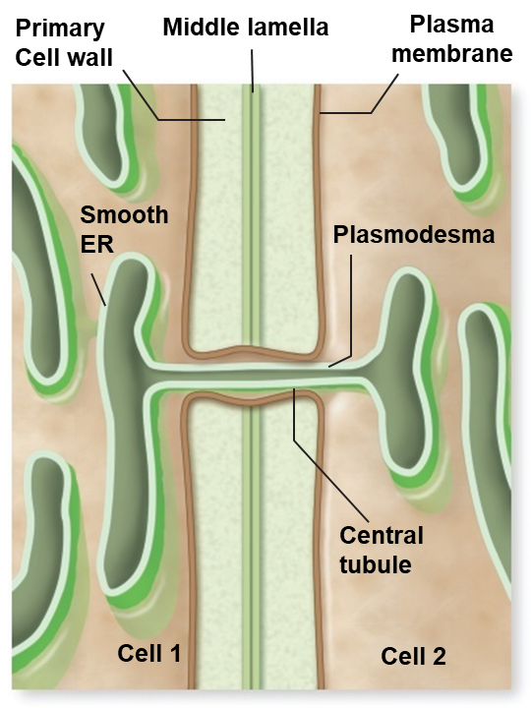
Plasmodesmata in Plant Cells
Plasmodesmata are channels that perforate plant cell walls
Through plasmodesmata, water and small solutes (and sometimes proteins and RNA) can pass from cell to cell

Slide 41
Tight Junctions, Desmosomes, and Gap Junctions in Animal Cells
At tight junctions, membranes of neighboring cells are pressed together, preventing leakage of extracellular fluid
Desmosomes (anchoring junctions) fasten cells together into strong sheets
Gap junctions (communicating junctions) provide cytoplasmic channels between adjacent cells

Slide 42
Structure Functions of cell membrane
is an extremely thin layer of lipids and proteins forming the outermost boundary of the living cell and enclosing the intracellular fluid (ICF).
Functions of membranes
encloses the cell & defines cell boundaries
determining the composition of cell by selective permeability of substances to pass between the cell and its ECF environment
Establish ion gradients across membranes
Can be used to synthesize ATP
Control movement of selected solutes or, in nerve and muscle cells, to produce and transmit electrical signals.
contains proteins that act as sensors of external signals

Slide 43
Cell membrane…
Membrane structure
Despite their differing functions, all biological membranes have a common general structure:
each is a very thin film of lipid bilayer and protein molecules, held together mainly by non-covalent interactions.
Fluid mosaic model of membrane
states that a membrane is a fluid structure with a “mosaic” of various proteins embedded in it
The components include phospholipids, cholesterol, proteins and carbohydrates in which the components are able to flow and change position

Slide 44
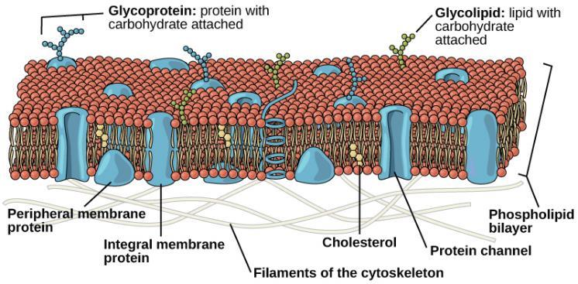
Importance of membrane fluidity
Fluidity of the membrane gives flexibility to the cell to change its shape; transport process are also dependent on the fluidity of the lipid bilayer.

Slide 45
Factors affecting Membrane fluidity
The fluidity of a lipid bilayer depends on both its composition (hydrocarbon chain length, degree of saturation, and amount of cholesterol) and temperature
The membrane becomes more fluid if the hydrocarbon chains are short or have double bonds.
Membranes rich in unsaturated fatty acids are more fluid than those rich in saturated fatty acids
Cholesterol because of its shape prevents long-chain fatty acids from packing close to each other at low temperature and increase membrane fluidity.
Fluidity increases with increased temperature

Slide 46
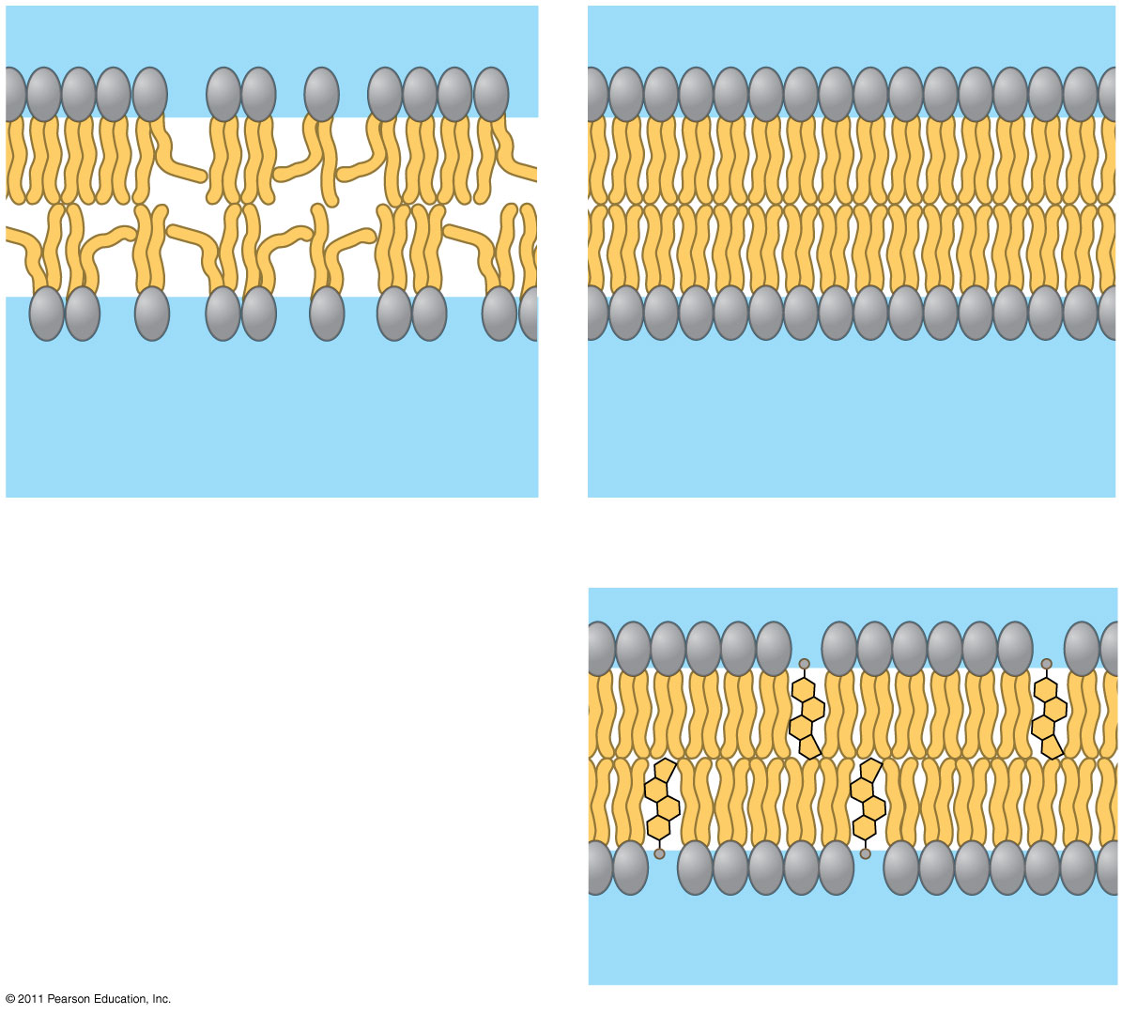
Fluid
Viscous
Unsaturated hydrocarbon
tails
Saturated hydrocarbon tails
(a) Unsaturated versus saturated hydrocarbon tails
(b) Cholesterol within the animal
cell membrane
Fig: Factors that affect membrane fluidity
Cholesterol
Notes:
Figure 7.8 Factors that affect membrane fluidity.

Slide 47
Composition of Lipid bilayer
The lipid bilayer of many cell membranes is composed of Phospholipids, Cholesterol, Carbohydrates (Glycolipids and glycoprotein) and proteins
Phospholipids
Two layers of phospholipids molecules make the main fabric of the membrane
are amphipathic molecules, containing hydrophobic and hydrophilic regions
  The hydrophilic (polar) ends of the phospholipids are in contact with the aqueous fluids inside and outside the cell
  The hydrophobic tails bury themselves in the center away from the water, while the hydrophilic heads line up on both sides in contact with water.

Slide 48
The lipid bilayer serves as a relatively impermeable barrier to the passage of most water- soluble molecules.
Protein molecules that span the lipid bilayer mediate nearly all of the other functions of the membrane, transporting specific molecules across it, or catalyzing membrane-associated reactions, such as ATP synthesis

Slide 49
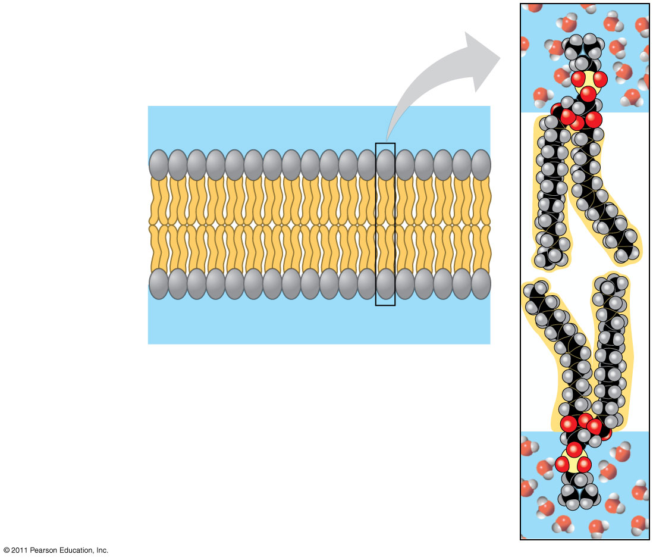
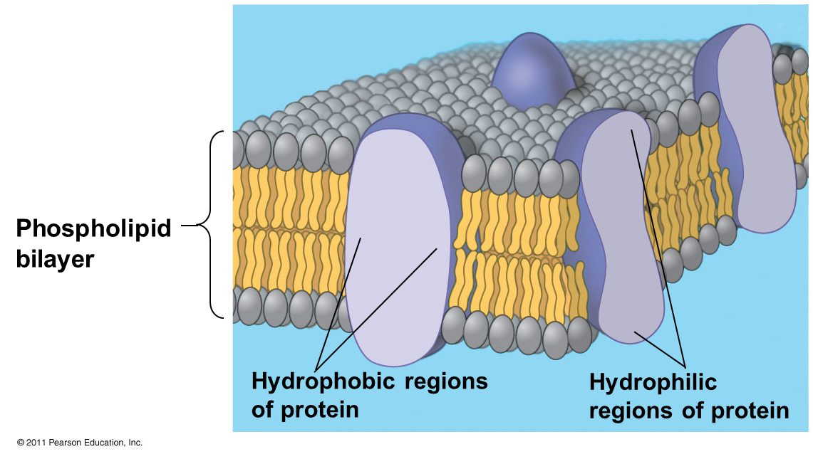
Phospholipid bilayer (cross section).
WATER
Hydrophilic
head
Hydrophobic
tail
WATER
Notes:
Figure 7.2 Phospholipid bilayer (cross section).

Slide 50
Carbohydrates in the memebrane
Short-chain carbohydrates are bound primarily to membrane proteins and to a lesser extent to lipids, forming glycoproteins and glycolipids.
Found only on the outer surface of the plasma membrane. This makes the cell membrane asymmetrical; i.e the two surfaces are not the same
vary among species, individuals, and even cell types in an individual
Functions
They act as antennae receiving chemical messages from other cells
They also serve as cell surface markers. Identify self cell from non-self

Slide 51
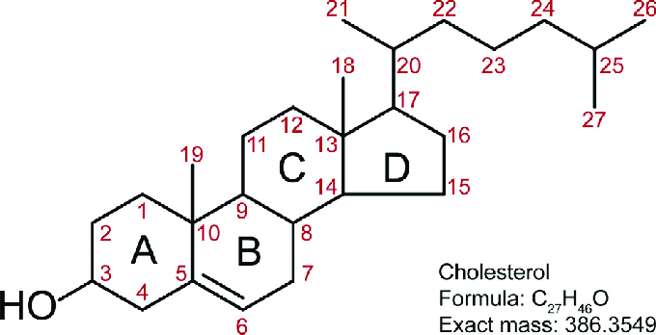
Cholesterol
It is a steroid, built from four linked hydrocarbon rings. A hydrocarbon tail is linked to the steroid at one end, and a hydroxyl group is attached at the other end.
Cholesterol is absent from prokaryotes but is found to varying degrees in virtually all animal membranes.
It constitutes almost 25% of the membrane lipids in certain nerve cells but is essentially absent from some intracellular membranes.

Slide 52
Membrane proteins
membrane proteins perform most of the specific functions of membranes
There are two classes of membrane proteins.
Peripheral proteins (or extrinsic proteins):
Do not penetrate the bilayer to any significant degree. It is associated with the membrane on its surface
2. Integral proteins
Also known as intrinsic proteins or transmembrane proteins
penetrate the lipid bilayer

Slide 53
Membrane proteins…
Functions of membrane proteins
Transport Proteins: transport lipid insoluble molecules and ions across the membrane
Receptor Proteins: Bind to chemical messengers (Ex. hormones) which send a message into the cell
Enzymatic Proteins: Carry out enzymatic reactions right at the membrane when a substrate binds to the active site
Cell Recognition Proteins: Glycoproteins (and glycolipids) on extracellular surface serve as ID tags (which species, type of cell, individual)
Attachment Proteins: Attach to the cytoskeleton to maintain cell shape
Intercellular Junction Proteins: Bind cells together

Slide 54
Membrane Transport
The internal composition of the cell is maintained because the plasma membrane is selectively permeable to small molecules.
Plasma membrane forms a barrier that blocks the free exchange of charged molecules between the cytoplasm and the external environment of the cell.
In general small non-polar molecules, such as O2 and N2 and small uncharged polar molecules, such as water readily dissolve in lipid bilayers and therefore diffuse rapidly across them.
By contrast, lipid bilayers are highly impermeable to charged molecules (ions) such as Na+ and K+ Cl-, HCO3-, small hydrophilic molecules like glucose, macromolecules like proteins and RNA can not freely diffuse through the plasma membrane

Slide 55
Membrane Transport
Types of Membrane Transport
Generally, there are two membrane transport systems based on energy requirements
Passive transport
  Simple Diffusion
  Facilitated Diffusion
2. Active transport
  Direct active transport
  Indirect Active transport

Slide 56
Membrane Transport
Passive transport
a naturally occurring phenomenon in which substances move from an area of higher concentration to an area of lower concentration in a process called diffusion
Simple Diffusion is the movement of molecules from a region of high concentration to a region of low concentration (down” its concentration gradient)
  does not need energy for the process.
  No membrane proteins are involved

Slide 57
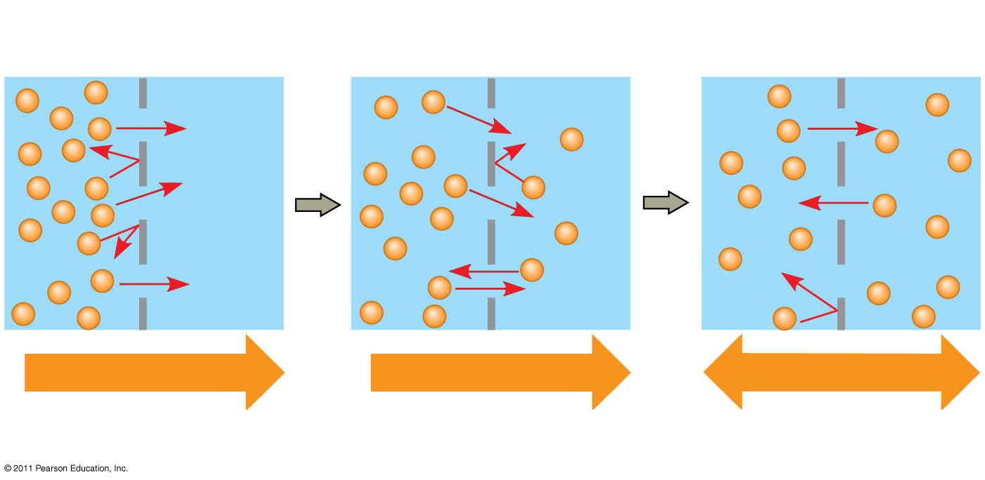
Molecules of dye
Membrane (cross section)
WATER
Net diffusion
Net diffusion
Equilibrium
(a) Diffusion of one solute
Notes:
Figure 7.13 The diffusion of solutes across a synthetic membrane.

Slide 58
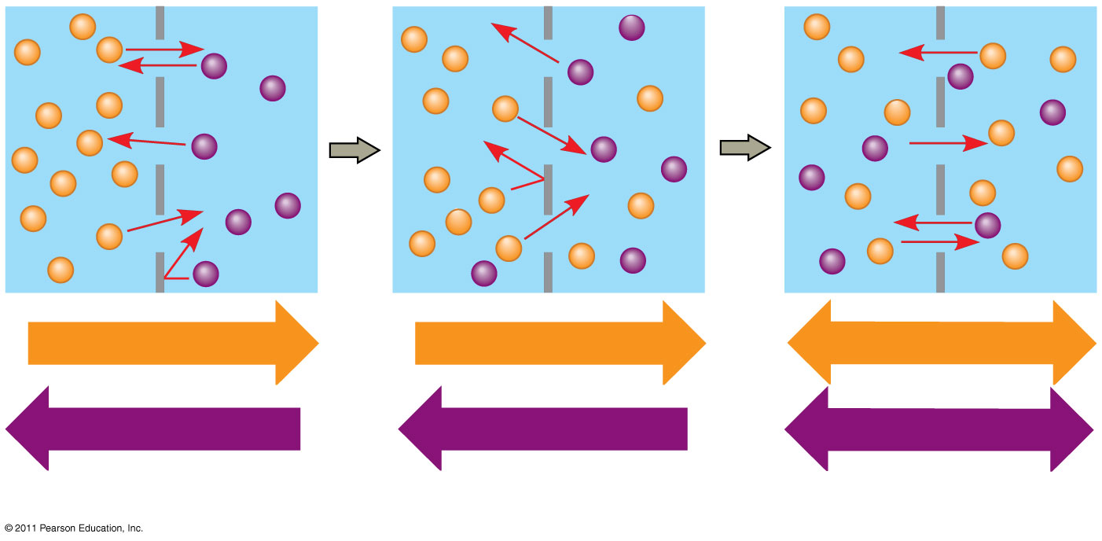
Figure 7.13b
Net diffusion
Net diffusion
Equilibrium
Net diffusion
Net diffusion
Equilibrium
(b) Diffusion of two solutes
Notes:
Figure 7.13 The diffusion of solutes across a synthetic membrane.

Slide 59
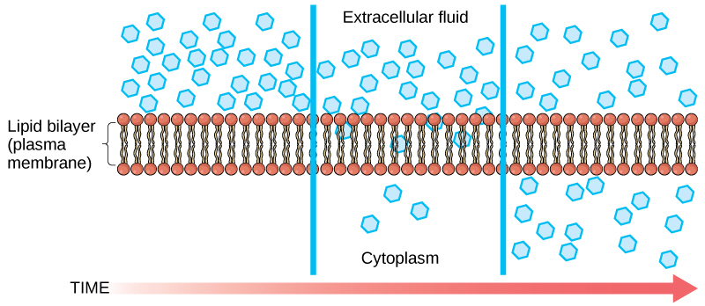
Membrane Transport
Molecules that can pass through plasma membrane by simple diffusion are
Gases (such as O2 and CO2)
Hydrophobic molecules (such as benzene)
Small polar but uncharged molecules (such as H2O and ethanol) are able to diffuse across the plasma membrane.

Slide 60
Membrane Transport
Several factors affect the rate of diffusion:
  Concentration gradient – the greater the difference in concentration, the more rapid the diffusion
  Mass of the molecules diffusing – the more massive a molecule is the slower it will diffuse
  Temperature – higher temperatures increase the rate of diffusion
  Distance travelled– as the distance increases, the rate of diffusion decreases

Slide 61
Membrane Transport
Facilitated Diffusion
  moves materials across the plasma membrane with the assistance of transmembrane proteins
  The transport is down the concentration gradient (from high to low concentration)
  Needs no expenditure of cellular energy
  It allows the movement of polar and charged molecules, such as carbohydrates, amino acids, nucleosides, and ions, to cross the plasma membrane.
  The direction of their transport is determined both by the concentration and voltage(electrical) differences- Electrochemical gradient

Slide 62
Membrane Transport
Types of proteins that mediate facilitated diffusion
Channel proteins.
carrier proteins
Channel proteins
form a hydrophilic passageway across the membrane through which polar molecules or ions move. include
Aquaporins, for facilitated diffusion of water
Ion channels that open or close in response to a stimulus (gated channels)

Slide 63
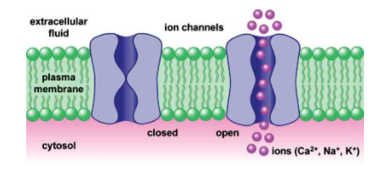
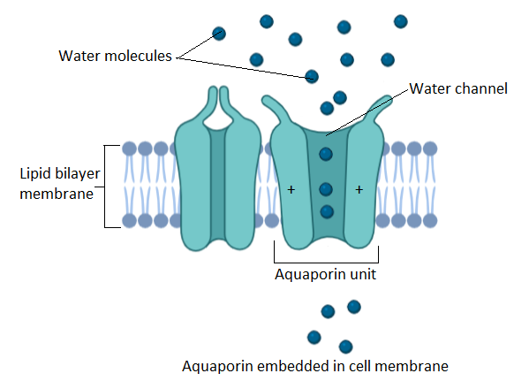

Slide 64
Membrane Transport
Carrier proteins (are also known as transporters)
Carrier proteins transport a wide variety of ions and molecules across cell membranes.
Three types of transporters have been identified
Uniporters: transport a single type of molecule down its concentration gradient via facilitated diffusion
Symporters are also known as Co-transporters: They transport two different solutes simultaneously in the same direction
Antiporters: are also known as counter transporters. They also transport two different solutes simultaneously but in the opposite direction

Slide 65
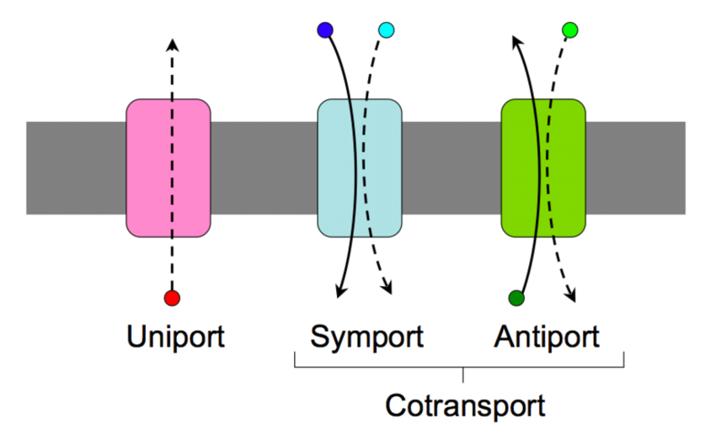

Slide 66
Membrane Transport
Osmosis - the diffusion of water through a semipermeable membrane
It is the movement of water from an area of high WATER concentration to an area of low WATER concentration
Water is the solvent (what does the dissolving), and the dissolved substance is called the solute
If the solute can not cross the membrane, the solvent (water) will

Slide 67
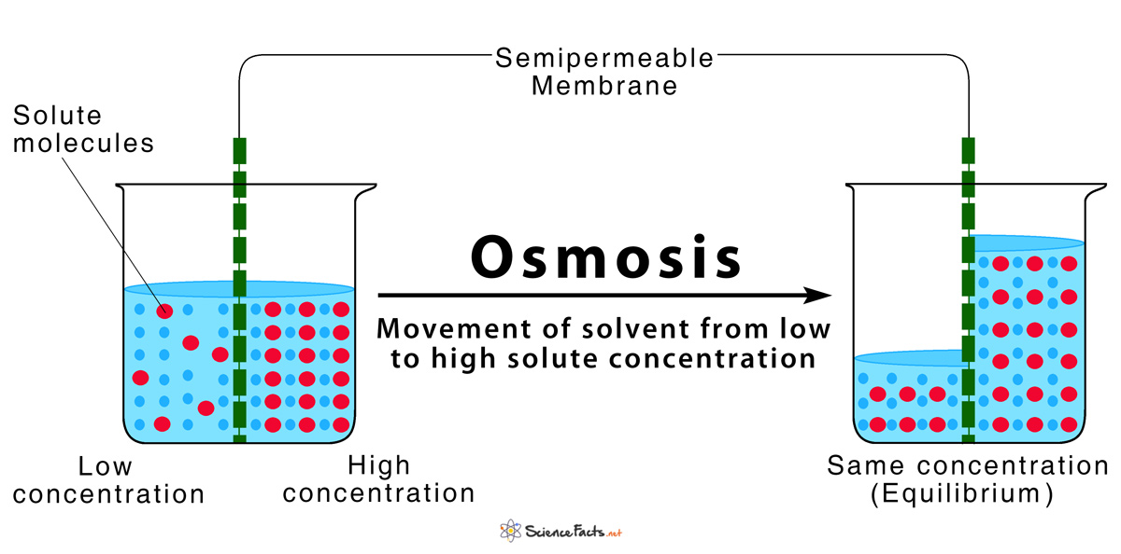
In osmosis, water always moves from an area of higher concentration of water (weak solution) to a lower concentration of water (strong solution). In this system, the solute cannot pass through the selectively permeable membrane.

Slide 68
Membrane Transport
Tonicity and Osmolarity
Tonicity describes the amount of solute in a solution
Osmolarity – the total amount of solutes dissolved in a specific amount of solution
Three terms are used to relate osmolarity of a cell to the osmolarity of the extracellular fluid:
Hypotonic – the extracellular fluid has a lower concentration of solute than the fluid inside the cell. This situation causes water to enter the cells and animal cells may burst, or lyse

Slide 69
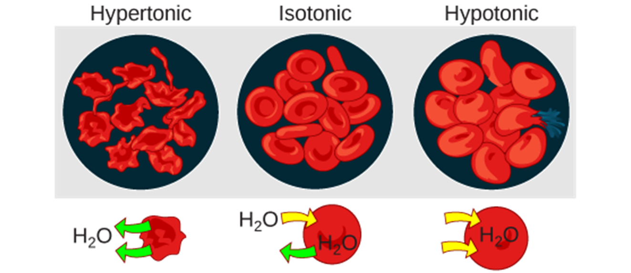
Membrane Transport
Hypertonic – the extracellular fluid has a higher concentration of solute than the fluid inside the cell. This situation causes water to leave the cells. This may cause animal cells to shrivel or crenate
Isotonic – the extracellular and intracellular fluid have equal concentrations of solute, water moves into and out of the cell at the same rate, so the cell remains normal
Osmotic pressure changes the shape of red blood cells in hypertonic, isotonic, and hypotonic solutions. (credit: modification of work by Mariana Ruiz Villarreal)

Slide 70
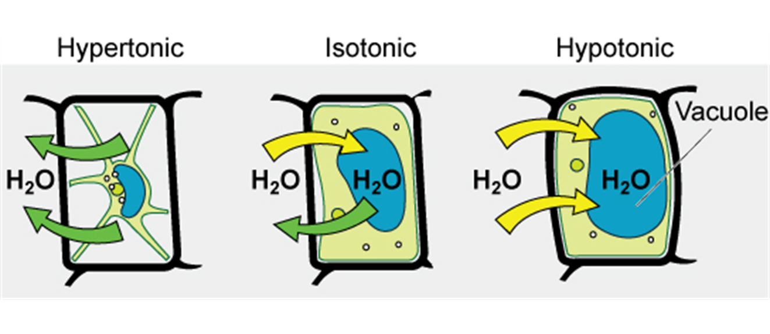
in cells that have a cell walls, such as plants, fungi, bacteria, and some protist
In a hypotonic solution, the plasma membrane can only expand to the limit of the cell wall, it won’t lyse
In a hypertonic solution, water will leave the cell, the plant will lose turgor pressure and wilt (Plasmolysis)

Slide 71
Active Transport
Active transport – the movement of materials AGAINST the concentration gradient from low concentration to the high concentration
Requires the cell to use energy (ATP) is performed by specific proteins embedded in the membranes
Active transport mechanisms, collectively called pumps or carrier proteins, work against electrochemical gradients
Example: sodium-potassium pump

Slide 72
Active .....
Types
Primary active transport
Secondary active transport
Endocytosis
      Pinocytosis
      Phagocytosis
      Receptor mediated endocytosis
Exocytosis

Slide 73
Active .....
Primary active transport
Examples - Na⁺ - K⁺ pump, Ca⁺⁺ pump, H⁺-K⁺ pump
Inner surface of carrier mol. has ATPase which is activated by attachment of specific ions and causes hydrolysis of ATP molecule
Energy released from ATP causes conformational change in the carrier which transports ions to the opposite side.

Slide 74
a) Na⁺ -K ⁺ pump- electrogenic pump
- Attachment of 2K⁺ on outer side & 3 Na⁺ on inner side
Activation of ATPase
3Na+
Conformational change
Efflux of 3 Na⁺ & influx of 2K⁺
ATPaes
2K+
Creates high K⁺ conc. & - vity inside the cell
Helps in maintaining cell volume

Slide 75
Active .....
Secondary Active Transport
uses the energy of the electrochemical gradient created by the primary active transport system to bring in other substances such as amino acids and glucose
  Active transport depending upon conc. gradient of Na+ from ECF to ICF created by utilization of energy-carrier, does not have ATPase activity
  Another substance (e.g. Glucose) is transported along with Na+
  Na+ is transported only when glucose mol. is attached

Slide 76
Active .....
Bulk Transport: Exocytosis and Endocytosis
Transports of large polar molecules
multimolecular material may leave or enter the cell, such as hormone secretion or ingestion of invading microbe by leukocytes
transport substance is enclosed in - vesicles
Transport into the cell is termed endocytosis, whereas transport out of the cell is called exocytosis

Slide 77
Active .....
Endocytosis
It is an active processes involving the bulk transport of materials through membranes, in to cells
It occurs by an in folding or extension of cell surface membrane to form a vesicle or vacuole
  Endocytosis can occur in three ways
    Phagocytosis ("cell eating")
    Pinocytosis ("cell drinking")
    Receptor-mediated endocytosis

Slide 78
Active Transport
Phagocytosis – the process by which large particles, such as cells, are taken in by a cell
Pinocytosis – the process by which fluids are taken in by a cell
Receptor-mediated endocytosis – the process by which particles bind to the receptor proteins, causing the plasma membrane to invaginate, bringing the particle and the proteins into the cell

Slide 79
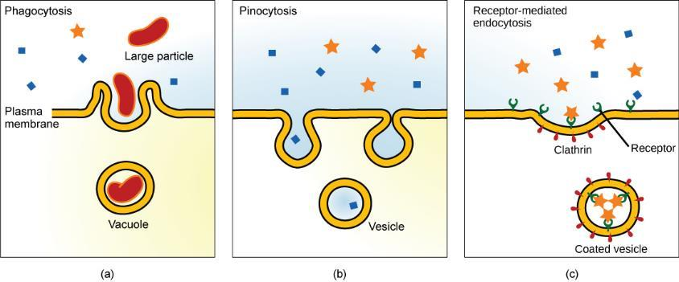
Three variations of endocytosis are shown.
In one form of endocytosis, phagocytosis, the cell membrane surrounds the particle and pinches off to form an intracellular vacuole.
In another type of endocytosis, pinocytosis, the cell membrane surrounds a small volume of fluid and pinches off, forming a vesicle.
In receptor-mediated endocytosis, uptake of substances by the cell is targeted to a single type of substance that binds at the receptor on the external cell membrane.

Slide 80
Active .....
Exocytosis
It is an active processes involving the bulk transport of materials through membranes (out of cells)
Exocytosis is the reverse process of endocytosis
Waste materials such as solid and undigested remains removed from cells
Secretion of enzymes from the pancreas is achieved in this way
Plant cells use exocytosis to export the materials needed to form cell wall

Slide 81
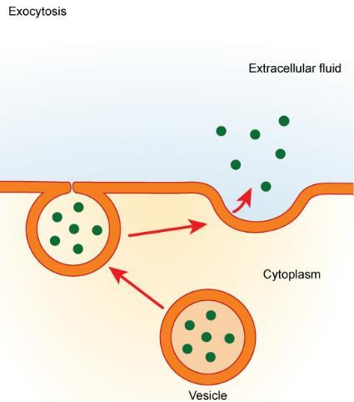
In exocytosis, a vesicle migrates to the plasma membrane, binds, and releases its contents to the outside of the cell.

